Slide 1
SOURCE CODE MANAGEMENT
Team Details :
Harshdeep Singh - 2410991322
Harshita - 2410991336
Harwinder Kaur - 2410991340
Laksh Mittal - 2410991365
Faculty Coordinator:
Dr. Sunil Gupta (Associate Professor)
Chitkara University Institute of Engineering and Technology, Chitkara University, Punjab

Slide 2
Table of Contents
Project Overview
Technology Stack
Installation & Setup
Usage
Version Control with GIT
Features
Contribution

Slide 3

Introduction
Title: Online Bookstore
Team Members:
Harshdeep Singh – 2410991322
Harshita - 2410991336
Harwinder Kaur - 2410991340
Laksh Mittal - 2410991365
Description: Our online bookstore is a digital platform that offers a wide range of books for sale, allowing customers to browse, purchase, and download or receive books from the comfort of their homes. It provides an accessible and convenient alternative to traditional brick-and-mortar bookstores, catering to readers across the globe. It provides readers with the convenience of shopping from home, instant access to digital content, and the ability to discover a vast variety of books from across the world. Our online bookstore offers readers easy access to their favorite titles and help them discover new ones

Slide 4
Technology Stack
Components | Technology
Front end | HTML, CSS, JAVASCRIPT
Version Control | GIT and GitHub
Hosting | GitHub Pages
The frontend of a website is built using HTML (for structure), CSS (for styling), and JavaScript (for interactivity).
Git is a distributed version control system used to track changes in source code during software development. It allows multiple developers to work on a project simultaneously, providing tools to collaborate, merge changes, and manage different versions of code efficiently.
GitHub Pages is a feature provided by GitHub that allows you to host static websites directly from a GitHub repository..

Slide 5
Installation & Setup
Pre-requisites for Setting Up the Online Bookstore Website :
Before starting the project, ensure you have the following installed and set up:
Git: Download and install Git from git-scm.com to manage version control. After installation, verify it by running git --version in Git Bash.
Code Editor (VS Code Recommended): Download Visual Studio Code for editing and managing your project files. You can also install Git extensions for easy integration.
GitHub Account: Sign up at GitHub.com to store and collaborate on your project. Set up a Personal Access Token if required for authentication.
Basic Command Line Knowledge: Understanding basic Git commands (git init, git add, git commit, git push) will help you efficiently manage project versions and collaborate with your team.

Slide 6


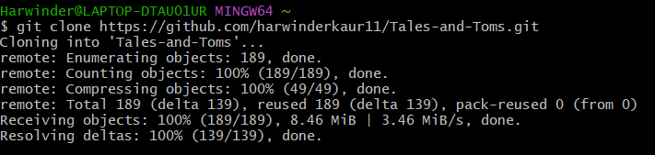
Installation & Setup
Steps to Set Up the Project :
Step 1: Cloning a GitHub Repository
Open your terminal or command prompt.
Run the following command to clone the repository.
Step 2: Navigate to the Project Directory
After cloning, navigate to your repository folder with this command:

Slide 7
Installation & Setup
Step 3: Open the Project in a Code Editor
Open the project in your preferred code editor
For Visual Studio Code, run the following command:

Slide 8
Usage Guide
For Users – Browsing Books according to their need
STEPS:
Open the Website: Go to the website URL in your browser.
Browsing the Menu: Navigate through the homepage to find the categories(e.g fictional, non-fictional, horror etc.)
Adding Items to the Cart: To add an item , click on the “Add to Cart” button next to the desired book.
Proceeding to Checkout: Click on the “Checkout” button once you are satisfied with the order.

Slide 9
Usage Guide
For Developers - Setting Up the Project
Steps :
Clone the Repository
Navigate to the Project Directory
Use Git to commit and push updates

Slide 10

Version Control
Initializing Git in the Project :
Adding Files to Git :
Committing Changes :

Slide 11
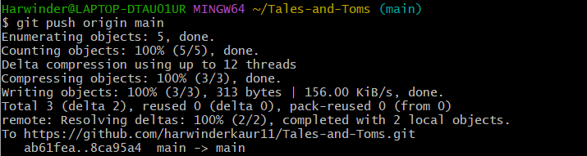
Version Control
Pushing to GitHub :
Updating Website with New Changes :
Make changes to the code.
Use git add . to stage changes.
Use git commit -m "Update description" to commit changes.
Use git push origin main to push the updated code to GitHub.

Slide 12
Features
Responsive Website
A responsive design ensures that the website adapts to different screen sizes and devices (desktop, tablet, mobile).
Key Benefits:
Mobile-friendly experience – Users can browse and purchase books from their phones.
Flexible layouts – The website automatically resizes elements to fit various screens.
Better SEO ranking – Google prioritizes mobile-friendly websites.
CSS Media Queries – Used to adjust styling for different screen sizes.
Hosted on GitHub Pages
GitHub Pages allows you to host your website for free directly from your GitHub repository.
Key Benefits:
No server setup required – Handles hosting, eliminating the need for third-party hosting services.
Automatic updates – Any changes pushed to the main branch are instantly reflected on the live website.
Free & secure – No additional cost, with HTTPS support for security.

Slide 13
Features
Version Control with Git
Git helps manage changes to your project by tracking modifications, allowing collaboration, and providing a backup.
Key Benefits:
Keeps track of all changes – You can revert to previous versions if needed.
Enables team collaboration – Multiple members can work on the same project without conflicts.
Branching system – Developers can work on separate features without affecting the main code.
Prevents accidental data loss – Every commit is a saved snapshot of the project.
Easy to Modify and Update
Your Online Book Store Website is designed for easy modifications and future updates.
Key Benefits:
Modular code structure – HTML, CSS, and JavaScript files are neatly organized for easy editing.
Version control integration – Any modifications can be tracked using GitHub.
Scalability – New features like user authentication, payments, and advanced filtering can be added later.

Slide 14

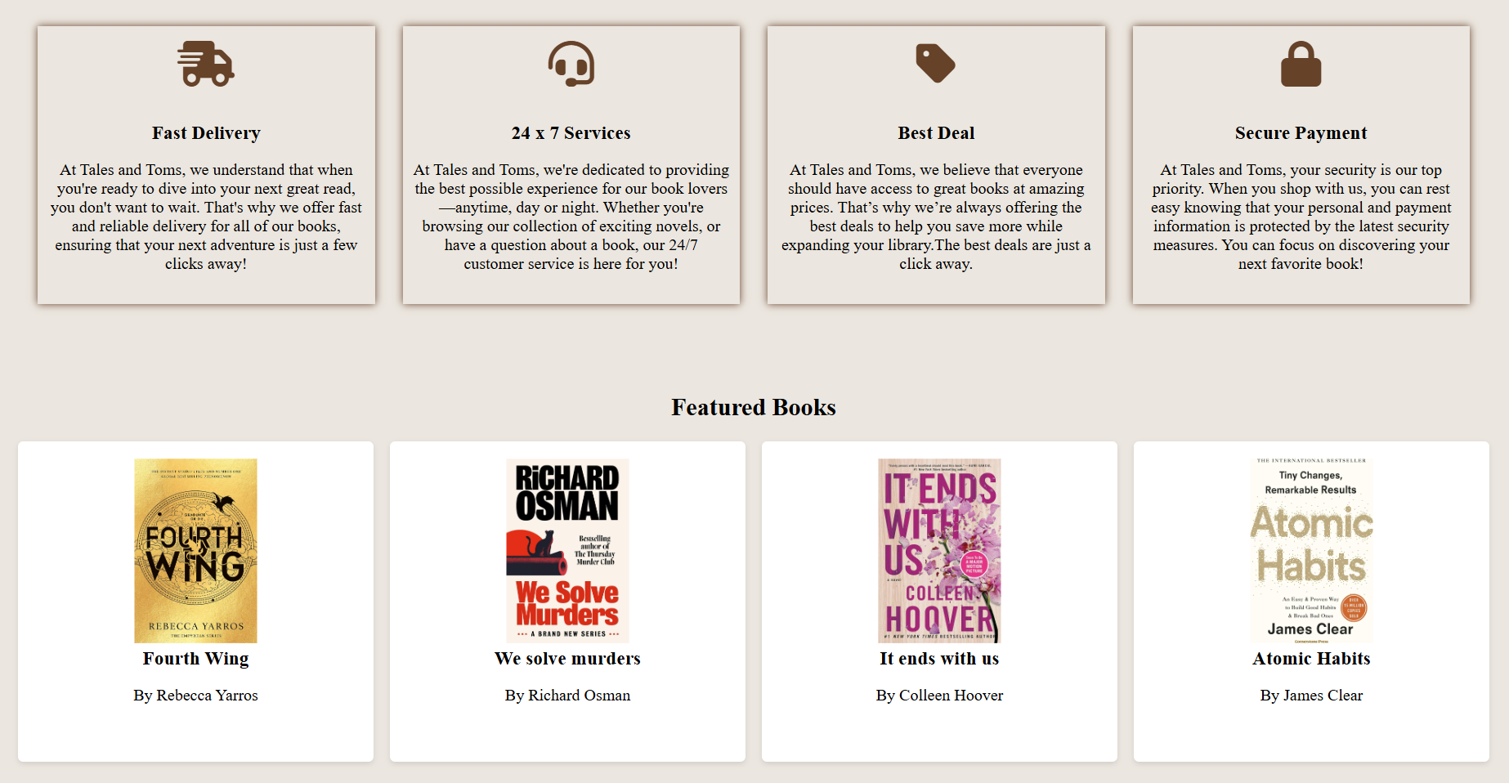
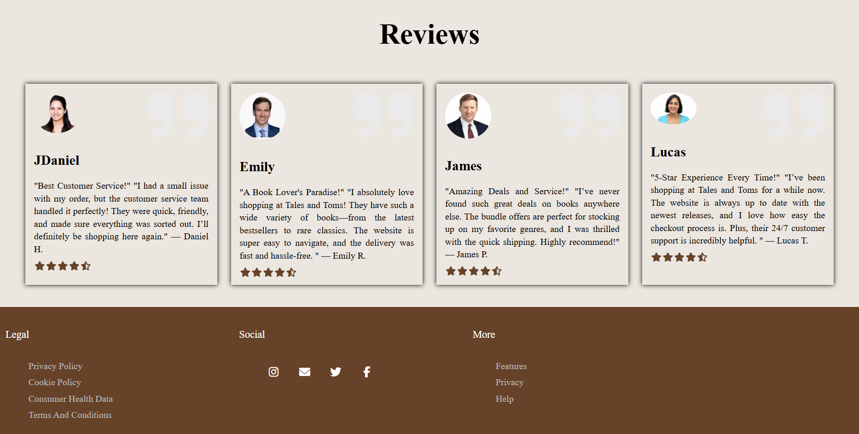

Project Highlights

Slide 15
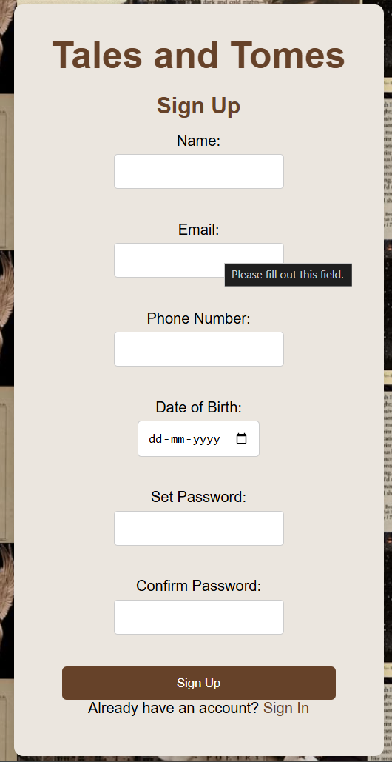
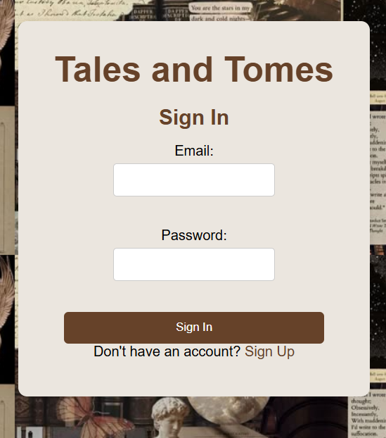
Project Highlights

Slide 16

Project Highlights

Slide 17


Contribution
Members | Tasks Assigned
Member 1 (Repository Manager) | -Create GitHub repository & add collaborators Initialize Git in the project (git init) Set up GitHub Pages to host the website
Member 2 (Developer & Commit Manager) | -Add project files to Git (git add .) Make the first commit (git commit -m "commit") Push code to GitHub (git push origin main) Update files & commit changes
Member 3 (Branch & Merge Manager) | -Create & manage new branches (git checkout –b NewBranch) Merge pull requests into main Resolve conflicts (if any)
Member 4 (Deployment & Documentation Lead) | -Enable GitHub Pages for hosting Verify the live website & report issues Write and maintain project documentation (README.md)

Slide 18


